Slide 1
Tracking & Predicting Antisemitic and Anti-LGBTQ+ Hate Crimes in the United States
Emily Diamond & Marin Moore

Slide 2
The FBI Hate Crimes Dataset
This dataset includes all hate crimes reported to the FBI from 1991 to 2024.
Features include:
Geographic data (city, state, region)
Offender data (count, age, race, ethnicity)
Victim data (count, age, race, ethnicity)
Incident data (offense type, bias type)
We selected only data from the years 2014 to 2024 to ensure relevance and to train a machine learning model on 10 years of data (2014-2013) and test it on the 2024 data.

Slide 3

Types of Hate Crimes

Slide 4
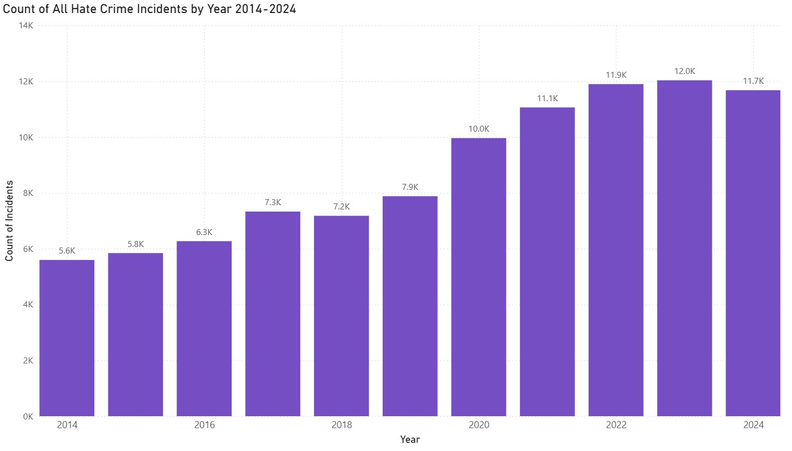
Basic EDA

Slide 5
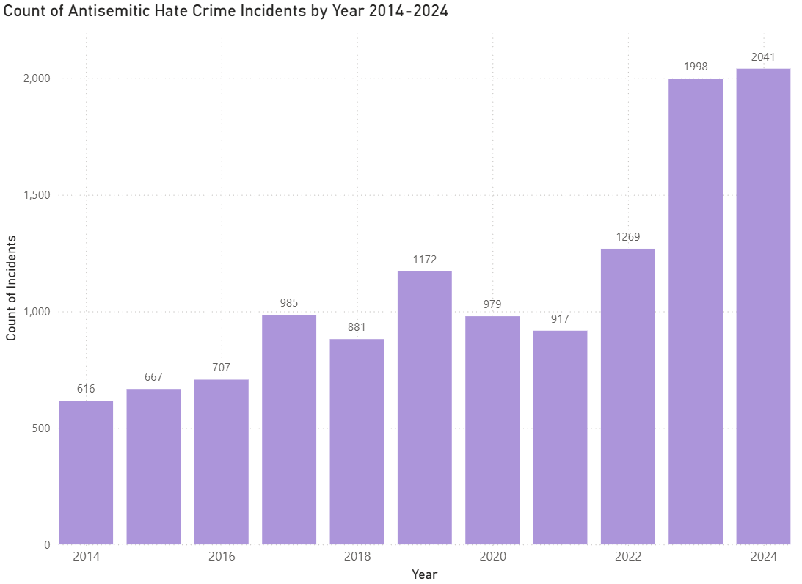
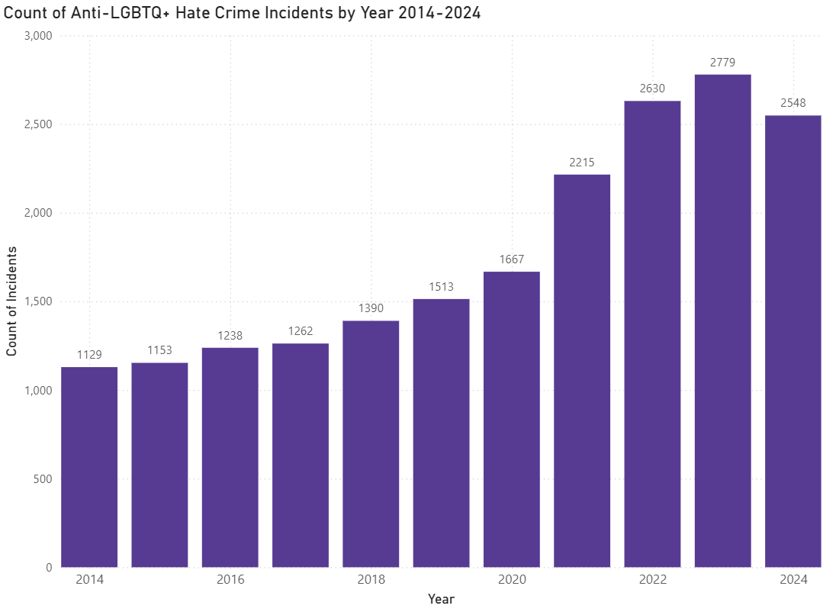
Basic EDA

Slide 6
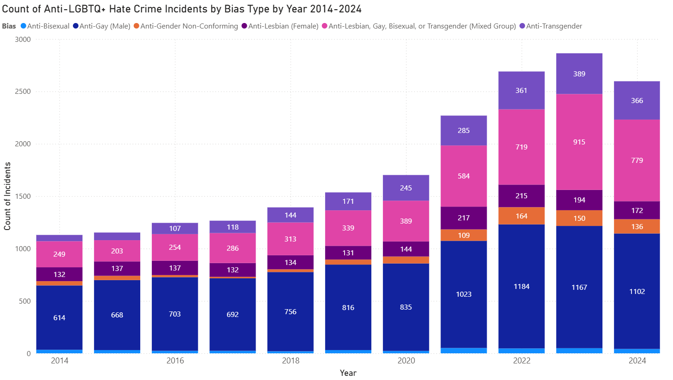

Slide 7
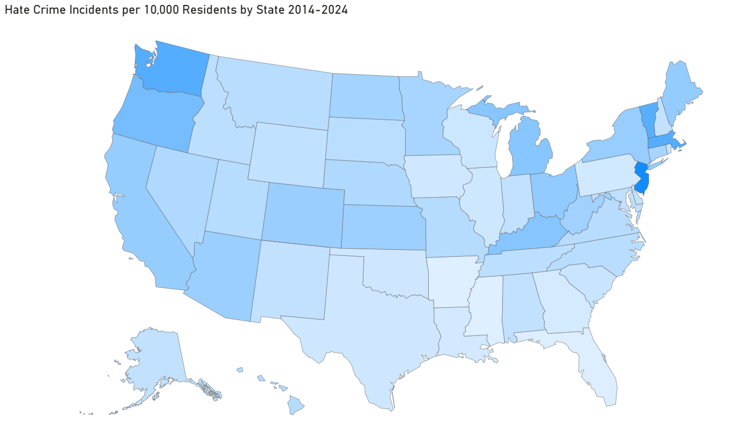
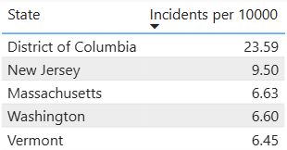
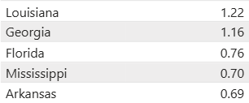
Basic EDA

Slide 8
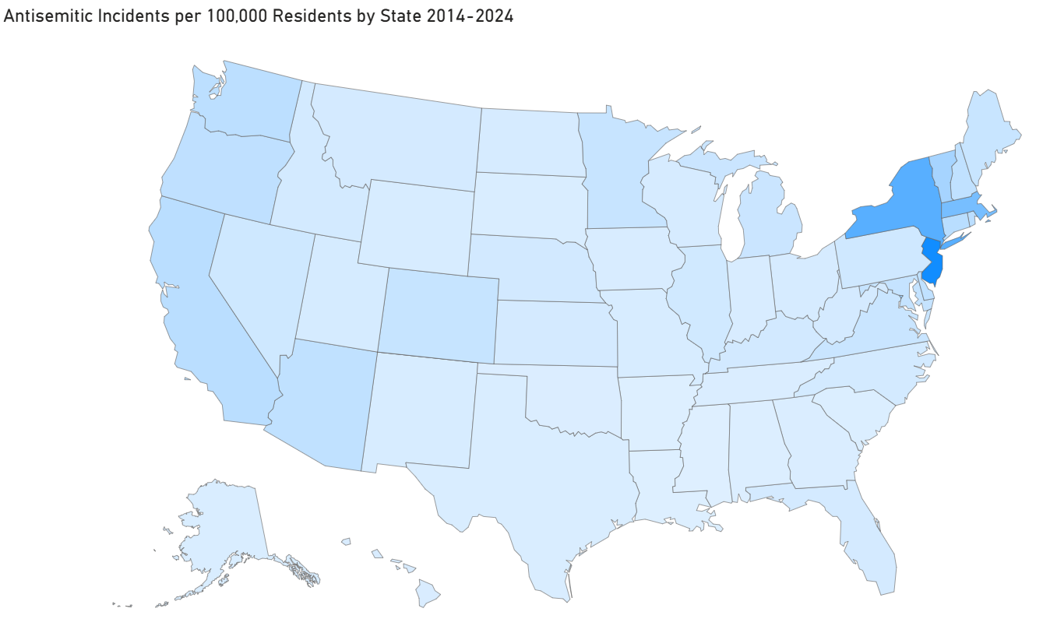
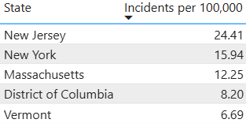
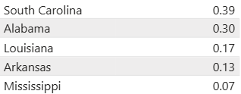
Basic EDA

Slide 9
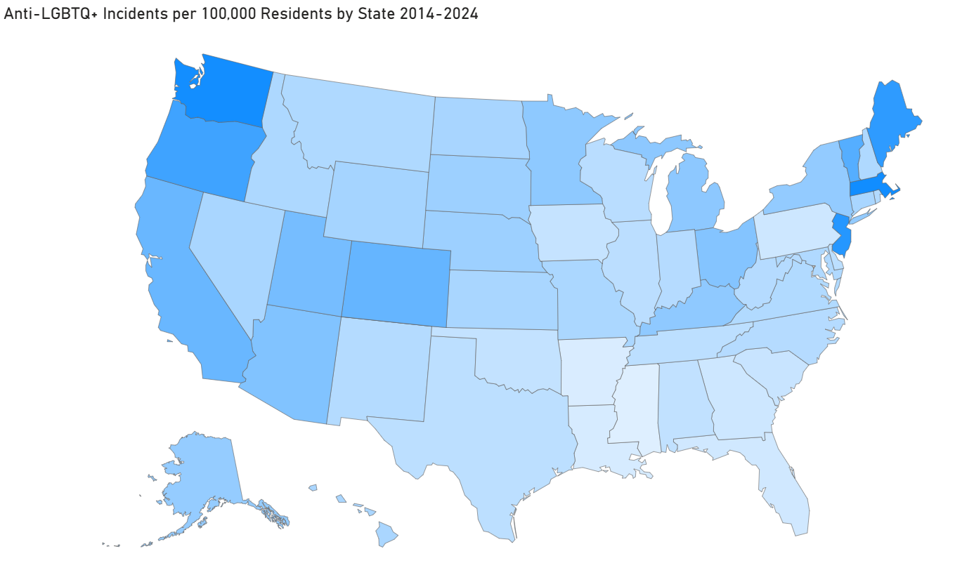
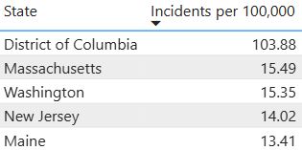
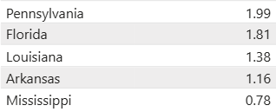
Basic EDA

Slide 10
The ADL Antisemitic Incident Dataset
We pulled data from the past 10 years (2015-2025) from the ADL Heat Map.
Features include:
Date/Year
City/State/Location Type
Type of Attack/Ideology
This dataset tracks Antisemitic white supremacist, and terrorist incidents only

Slide 11
Basic EDA
From the ADL dataset:
Number of Antisemitic Incidents: 37,004
Number of Antisemitic AND Anti-LGBTQ+ Incidents: 358
Percent of Antisemitic Incidents That Are Also Anti-LGBTQ+: 0.9675%
Although not incredibly high, there does appear to be a number of correlated incidents

Slide 12
Future Directions
Further EDA & machine learning model to predict antisemitic or anti-LGBTQ+ hate crimes based on the state’s:
Region
Proportion of Jewish population
Estimated proportion of LGBTQ+ population
Level of hate crime protections
Balance of pro- to anti-LGBTQ+ legislation
Conservative/liberal balance
Level of ethnic diversity

